Slide 1

Custom Bootcamp
Week 3 (Sep 4-Sep 8)
Pagidala Saketh Reddy
Employee code: 655074
Unext ID: SH7B23136

Slide 2

Agenda
Sep 4th– Azure Storage Types
Sep5th – Azure Data Factory
Sep 6th– Azure Data Factory
Sep 7th – Azure Data Factory
Sep 8th – Azure Data Factory (Case Study)

Slide 3
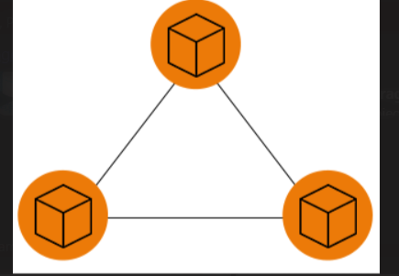
Azure Storage Types
Azure Blob Storage: For storing unstructured data like images and videos.
Azure File Storage: Managed file shares for sharing data between VMs.
Azure Queue Storage: Enables asynchronous communication in applications.
Azure Table Storage: NoSQL data store for key-value or tabular data.
Azure Disk Storage: Managed virtual disks for VMs.
Azure Data Lake Storage: Designed for big data analytics.

Slide 4
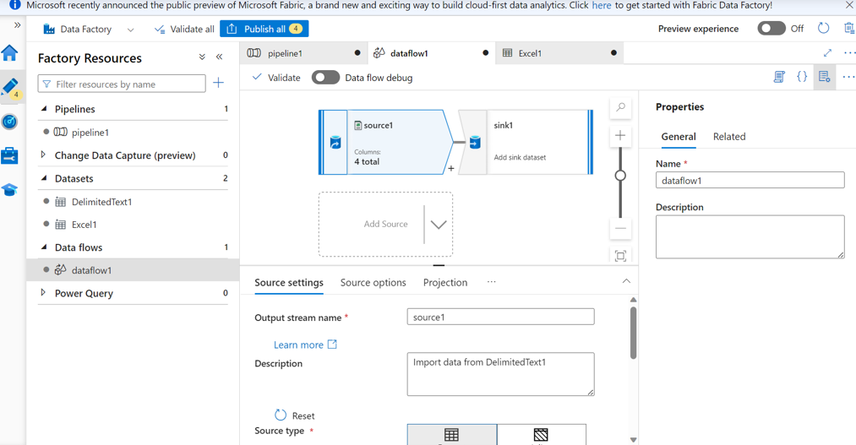
Azure Hands On
Introduction to LRS,ZRS,GRS and GZRS
Learned about Access Keys and Shared Access Signatures
Hands on data factory creation
Created a basic data pipeline

Slide 5
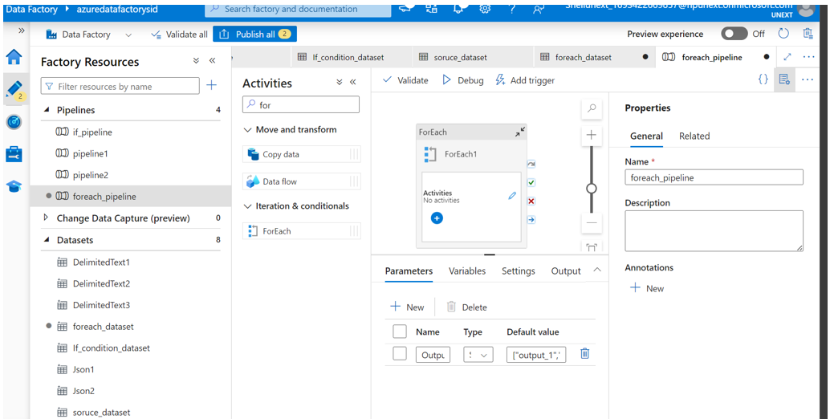
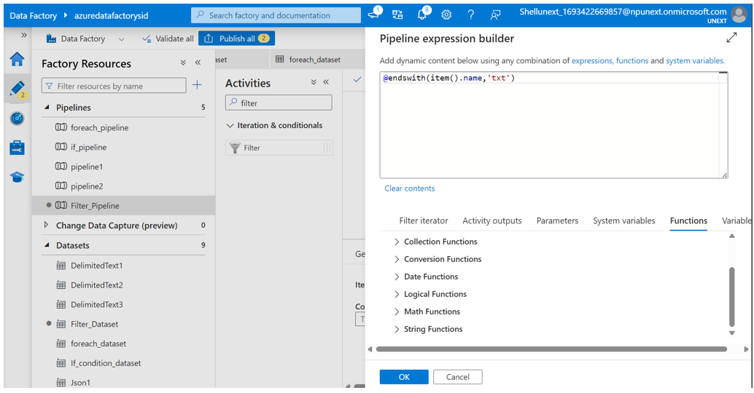
Azure Hands On
Hands on data pipeline creation for practicing different activities like if else,for each,filter,until,copy data
Learned how to use parameters

Slide 6
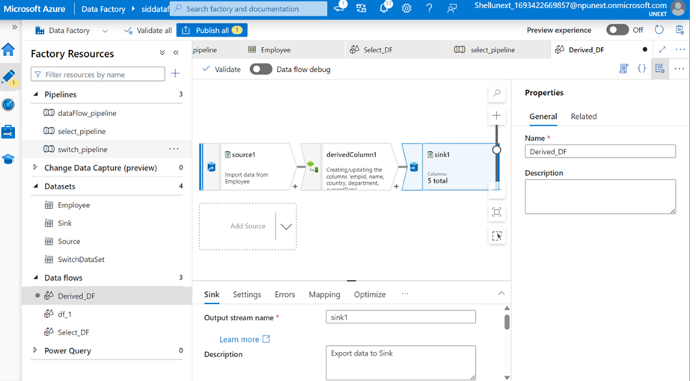
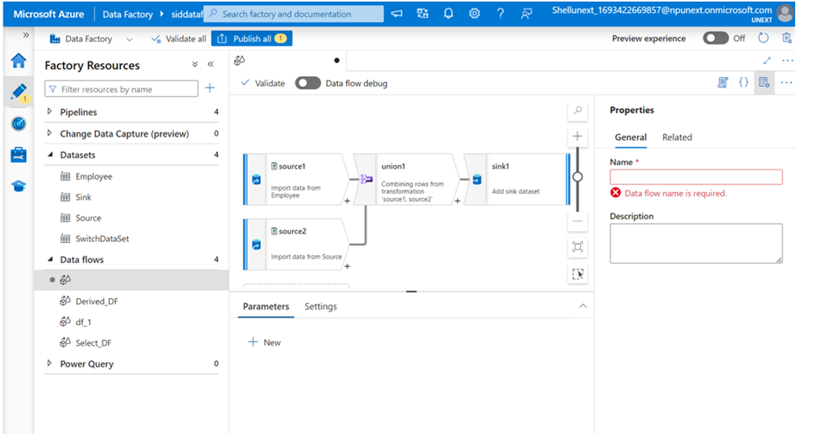
Azure Hands On
Hands on with switch activity
Created basic dataflow
Used select, filter, derived column, union, sort and conditional split while creating data flow

Slide 7
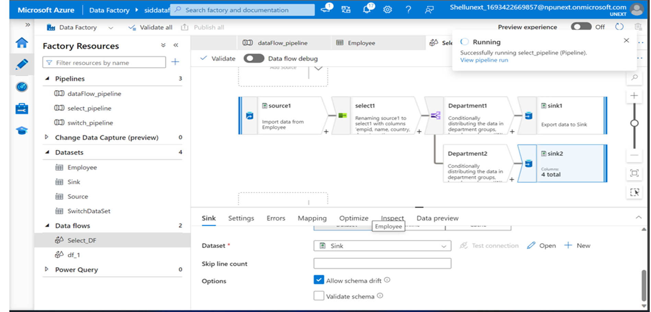
Azure Hands On

Slide 8
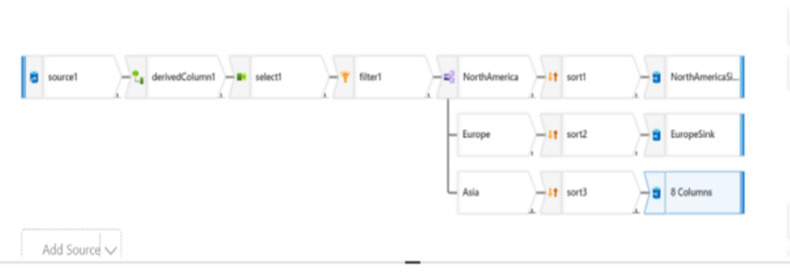
Azure Hands On
Case study in a group
Created Azure Sql database and server
Made a dataflow pipeline to convert sql table to csv
Used select,conditional split,derived column in the dataflow

Slide 9

Thank You

